Slide 1
The Management Challenge
Week 3

Slide 2
Constraints & Challenges

Slide 3
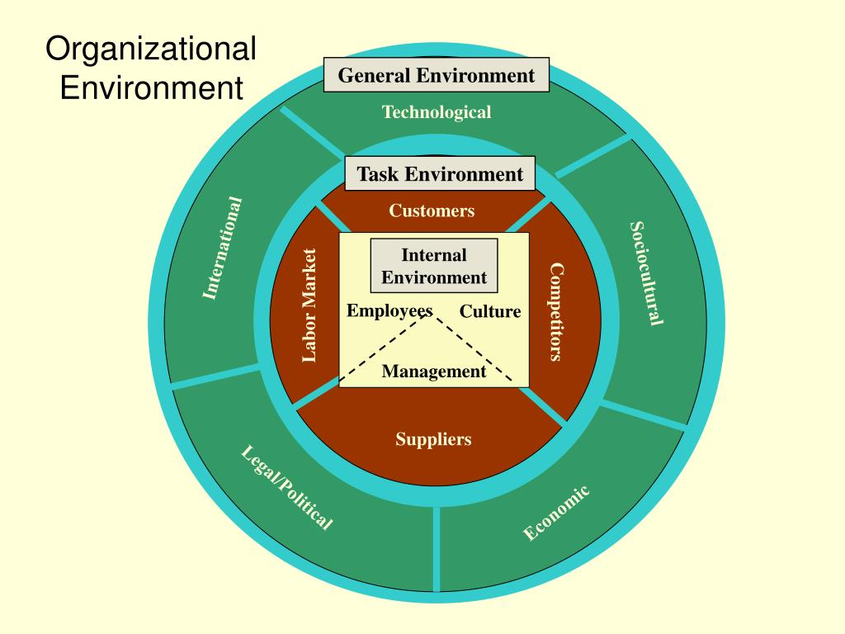

Slide 4
External Environment
General Environment
Task
Environment

Slide 5
The External Environment
“The external environment includes all elements existing outside the boundary of the organization that have the potential to affect the organization.”
Competitors
Resources
Technology
Economic Conditions

Slide 6
The General Environment
“The general environment is the outer layer that is widely dispersed and affects organizations indirectly.”
Social
Demographic
Economic
Examples:
Increase in inflation rate
Increase in dual-career couples
Ageing population

Slide 7
The General Environment: Dimensions
The following dimensions influence the organization over time, but often are not involved in day-to-day transactions with it.
International Dimension
Technological Dimension
Sociocultural Dimension
Economic Dimension
Legal-Political Dimension

Slide 8
The General Environment: International Dimension
“Represents events originating in foreign countries as well as opportunities for national companies in other countries.”
New competitors
New customers
New Suppliers
Shape Technological trends
Shape Economic trends

Slide 9
The General Environment: Technological Dimension
“This includes scientific and technological advancements in a specific industry and society at large.”
It has changed the nature of competition and organization’s relationships to customers.
What technological advances can you think about?

Slide 10
The General Environment: Sociocultural Dimension
“Represents the demographic characteristics as well as the norms, customs, and values of the general population.”
Geographical distribution
Population density
Age
Education levels
Norms and values
Today’s demographic profiles are the foundations of tomorrow’s workforce and consumers.
What is Pakistan’s demographic profile?

Slide 11
The General Environment: Economic Dimension
“Represents the general economic health of the country or region in which the organization operates.”
Consumer purchasing power
Unemployment rate
Interest rates
Organizations are operating in global environment, creating complexity and uncertainty.

Slide 12
The General Environment: Legal-Political Dimension
“Includes governmental regulations at the local, state and federal levels as well as political activities designed to influence company behavior.”
Litigation and regulation
Pressure groups are interest groups that work within the legal-political framework to influence companies to behave in socially responsible ways.
Can you think of an example?

Slide 13
The Task Environment
“The task environment is closer to the organization and includes the sectors that conduct day-to-day transactions with the organization and directly influence its basic operations and performance.”
Competitors
Suppliers
Customers

Slide 14
The Task Environment: Customer Sector
“People and organizations in the environment who acquire goods or services from the organization”
Customers determine organization success.
Internet has enabled customers to share reviews and companies to understand customers.

Slide 15
The Task Environment: Competitor Sector
“Other organizations in the same industry or type of business that provide goods or services to the same set of customers”.
Companies are now turning towards collaborative projects, as Research and Development (R&D) budgets shrink around the globe.

Slide 16
The Task Environment: Supplier Sector
“The raw materials the organization uses to produce its output are provided by suppliers.”
Many companies are now using fewer suppliers and trying to build good relationships with them, to benefit from good quality at lower prices.
Cooperation is the key to saving money, maintaining quality, and speeding products to market.

Slide 17
The Task Environment: Labour Market
“It represents the people in the environment who can be hired to work for the organization.”
Unions
Employee associations
Availability of required employees

Slide 18
The Task Environment: Labour Market
Labour market forces affecting organizations:
1.Growing need for computer literate IT workers
2.continuous investment in HR through recruitment, education, and training
3. Effects of international trading blocs, automation, and shifting plant location on labour dislocations (shortage v/s excess labour).

Slide 19
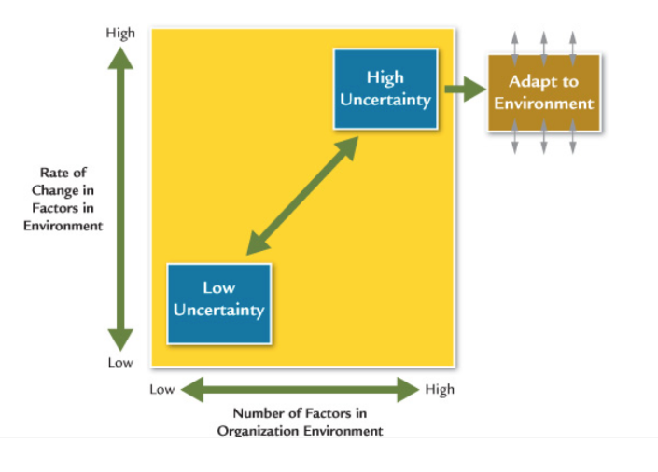
Organization-Environment Relationship
Organizations must manage environmental uncertainty to be effective.
Uncertainty means that managers do not have sufficient information about environmental factors to understand and predict environmental needs and changes.

Slide 20
Adapting to the Environment
Increased uncertainty due to competition, customers, suppliers, or government regulation, managers can use strategies to adapt:
Boundary-spanning roles
Interorganizational partnerships
Mergers or joint ventures
Flexible structure
Organic organizations create many teams to handle changes in raw materials, new products, government regulations, or marketing.

Slide 21
Internal Environment
“Internal environment includes the elements within the organization’s boundaries.”
Corporate culture
Production technology
Organizational structure
Physical facilities

Slide 22
Internal Environment-Corporate Culture
Corporate Culture defines employee behaviour in the internal environment and how well the organization will adapt to the external environment.
It is extremely important for competitive advantage.
The concept of culture helps managers understand the hidden, complex aspects of organizational life.
Culture is the set of key values, beliefs, understanding and norms that members of an organization share.

Slide 23
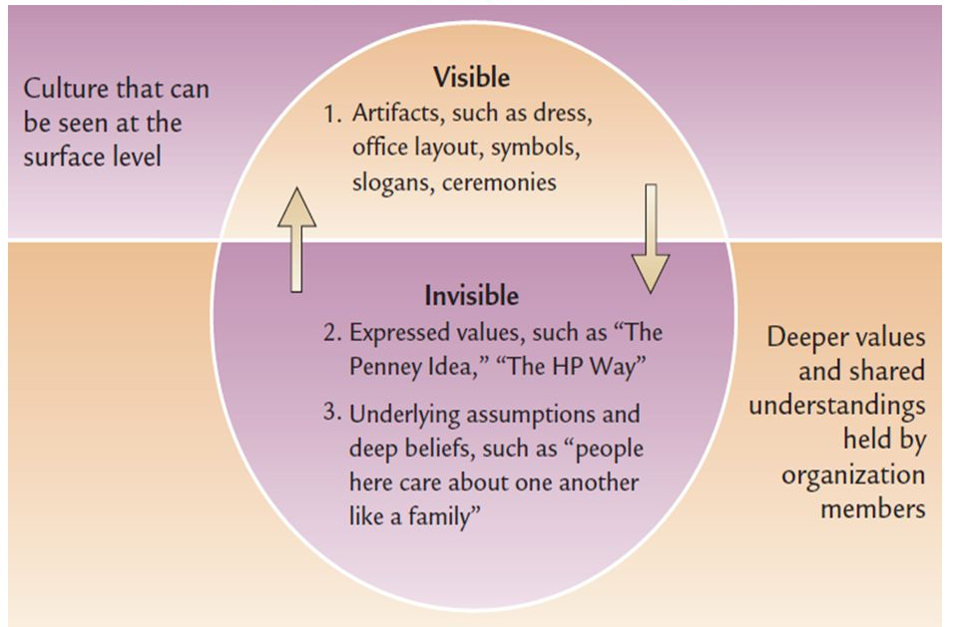

Slide 24
Internal Environment-Corporate Culture
The fundamental values that characterize cultures a companies can be understood through the visible manifestation of:
Symbols: an object, act, or event that conveys meaning to others
Stories:a narrative based on true events that is repeated frequently and shared by organizational employees
Heroes: a figure who exemplifies the deeds, character, and attributes of a strong corporate culture
Slogans: a phrase or sentence that succinctly expresses a key corporate value
Ceremonies:planned activity that makes up a special event and is conducted for the benefit of an audience

Slide 25
Environment & Culture
External environment has an influence over corporate culture.
Organizations within the same industry may often reveal similar cultural characteristics as they operate in similar environment.
Internal culture should embody what it takes to succeed in the environment.

Slide 26
Adaptive Culture
A strong corporate culture alone did not ensure business success unless the culture encouraged healthy adaptation to the external environment.
Adaptive corporate cultures have different values and behavior from unadaptive corporate cultures.

Slide 27
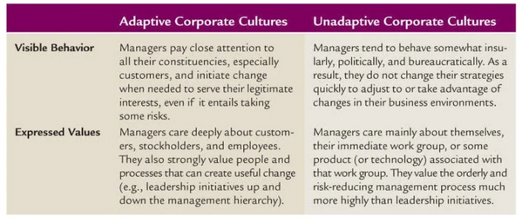

Slide 28
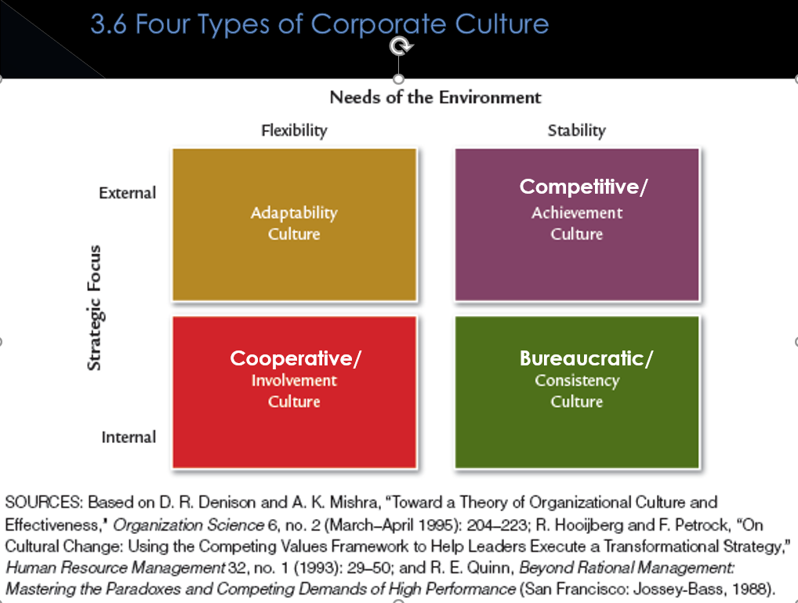
Types of Culture
Cultural values important for the organization are considered based on the external environment and the company’s strategy and goals.

Slide 29
Adaptability Culture
Emerges in an environment that requires fast response and high-risk decision making.
Managers encourage values that support the company’s ability to rapidly detect, interpret, and translate signals from the environment into new behaviour responses.
Employees have autonomy to make decisions and act freely to meet new needs, and responsiveness to customers is highly valued.
Creativity, experimentation and risk-taking is rewarded

Slide 30
Achievement Culture
Suitable for organizations that are concerned with serving specific customers in th external environment but without the intense need for flexibility and rapid change.
Result oriented culture that values competitiveness, aggressiveness, personal initiative, and willingness to work long and hard to achieve results.

Slide 31
Clan Culture
Internal focus on the involvement and participation of employees to rapidly meet changing needs from the environment.
High value is placed on meeting the needs of employees, and the organization may be characterised by a caring, family-like atmosphere.
Values encouraged are cooperation, consideration (both employees and customers), and avoiding status differences.

Slide 32
Bureaucratic Culture
Internal focus and consistency orientation for a stable environment.
Rule following and thriftiness is valued.
Culture supports and rewards a methodical, rational, orderly way of doing things.

Slide 33
Managing Culture in the New Workplace
Increasing emphasis on selection and socialization of new employees.
Written company values and their distribution in various forms; newsletters and magazines, videos, training classes,etc.

Slide 34
Cultural Leadership
A manager who uses signals and symbols to influence corporate culture.
Articulates a vision for the organization culture that employees can believe in and that generates excitement.
Heeds the day to day activities that reinforce the cultural vision.

